Slide 1
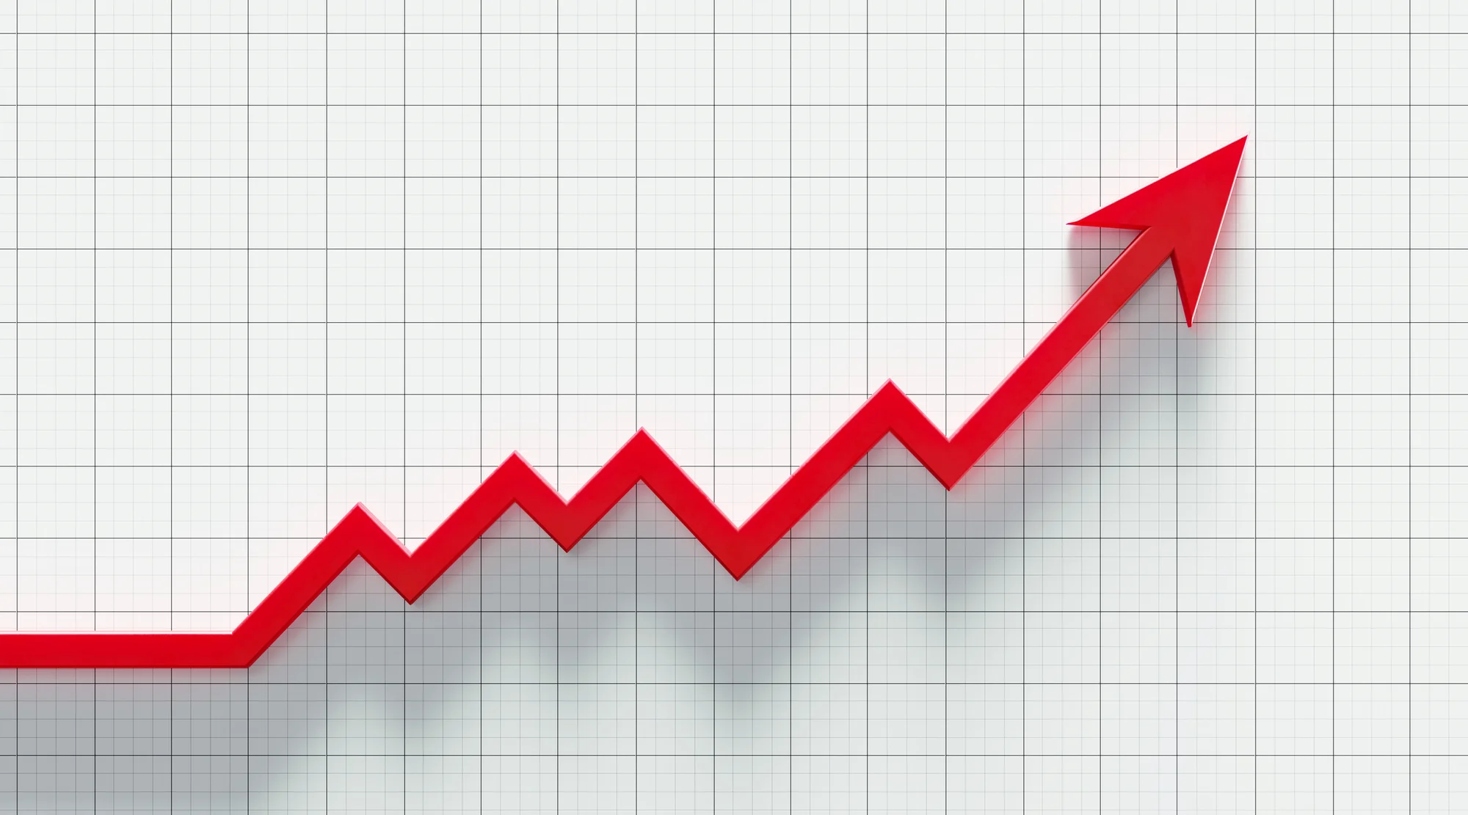
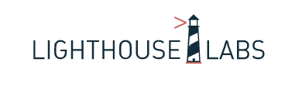
S&P 500 Index prediction
Irene Choi
Notes:
Hi My name is Irene and today I am presenting S&P 500 index prediction by classification model and time series.

Slide 2

Today’s Presenter - Irene
Bachelor’s degree in Business Administration, Economics
Been in Finance and Accounting over 9 years (U.S.CPA)
Stock investor since 2009
Disclaimer: This is not a stock investment recommendation.
Notes:
Let me quickly introduce my background. I have a bachelor’s degree in Business and Economics and have been in accounting over 9 years. I, myself, am a stock investor since 2009.

Slide 3
Problem
It is getting harder to retire with your labour income only! Investment is a must!
S&P index increases over time for sure! (Some stock price increase over time, but some don’t or go bankrupt)
What if we can find some patterns and predict next month’s return class(up/down/neutral) based on the current month information we have?
Notes:
People say saving your earning is not sufficient for retirement and you have to grow your money by investing it. There are a lot of ways to invest your money but it’s difficult if you don’t know where to begin, how to do it.
Investing in stock index reduces risks in investing individual stocks and gives fair return. However, what if we can find some patterns and predict next month’s return class(up/down/neutral) based on the current information we have?

Slide 4
Data Used
S&P 500 historical index /trading volume
Oil & gas / Gold / Gold future
Unemployment rate
Treasury bond(3months)/bill(10years) yield
CPI
Consumer Sentiment index
FX (CAD/USD)
S&P monthly P/E, Dividend, Earning yield ratio
Other stock market indices – Nasdaq, Russell2000, Nikkei
Notes:
For the classification, I used S&P index, trading volume, economic indicators such as CPI, Consuer Sentiment index, other stock market indices,

Slide 5
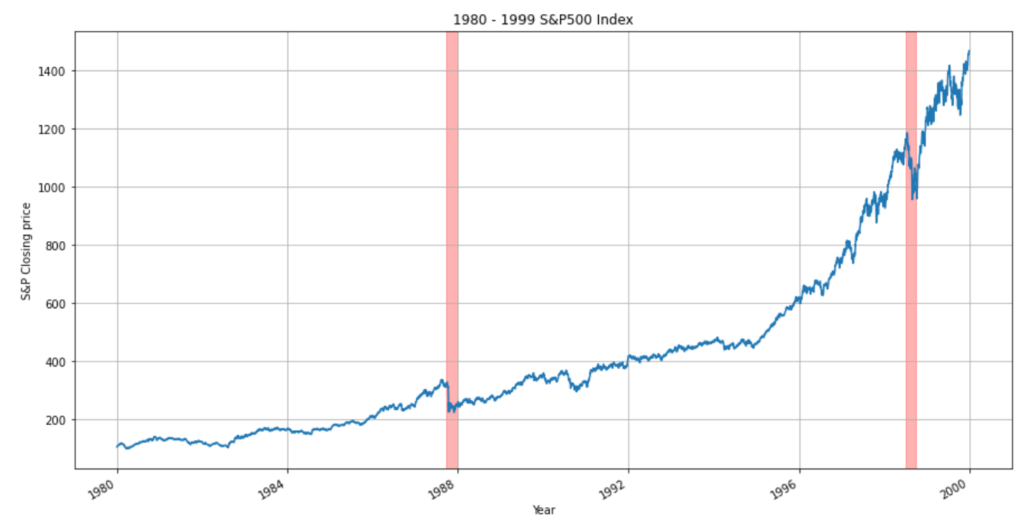
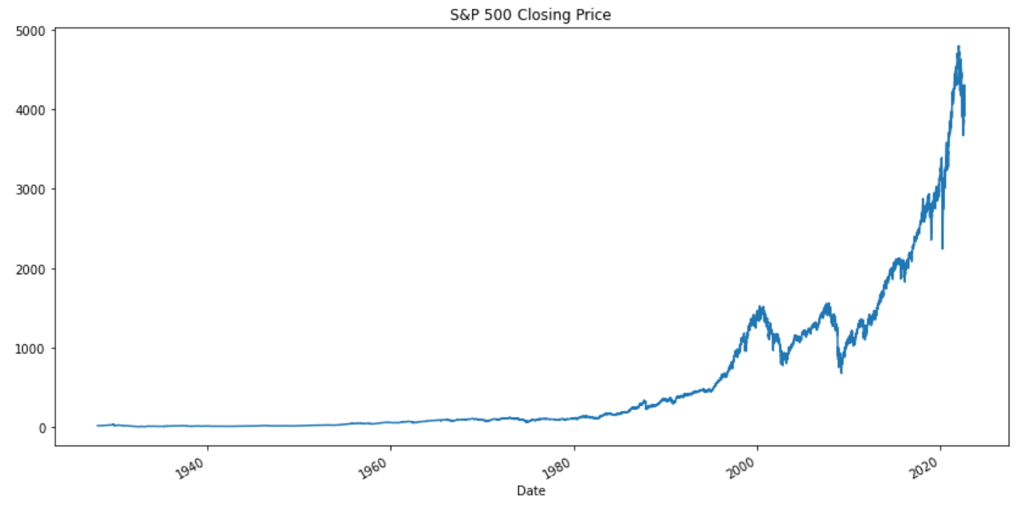
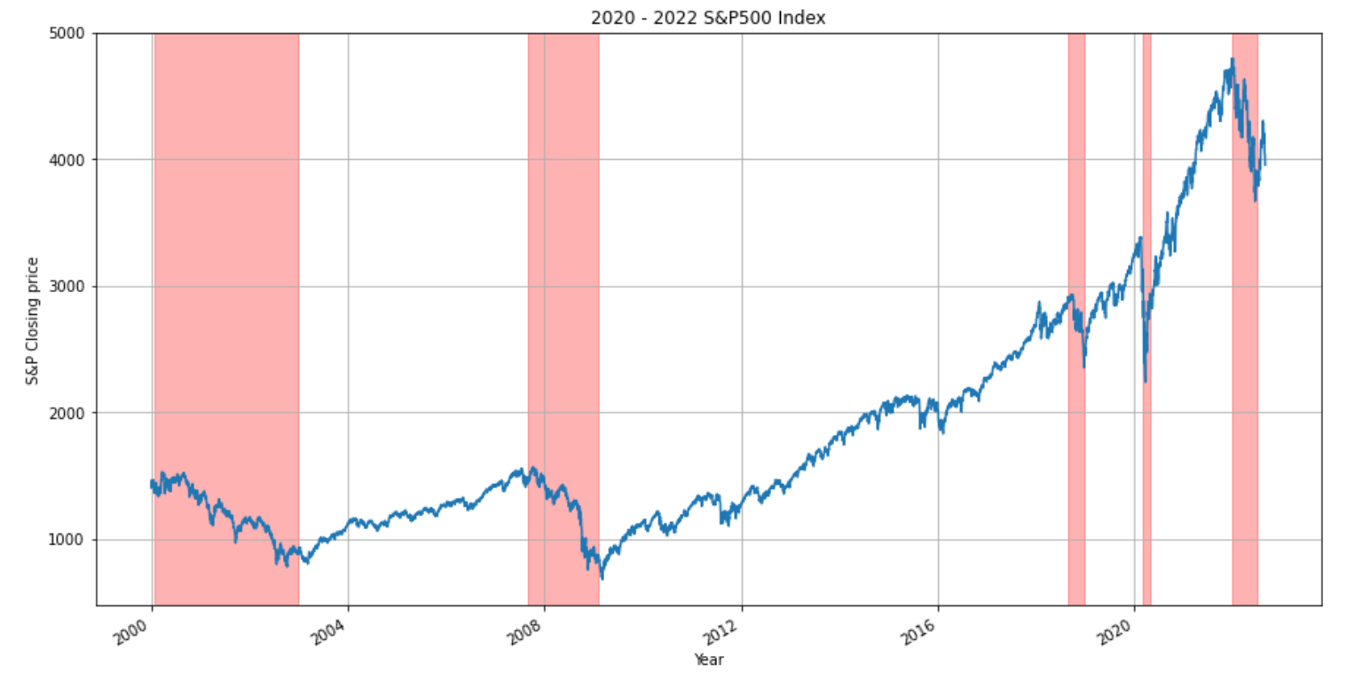
Exploratory Data Analysis
Notes:
This is the S&P historical index and you can see there are a few market down and ups every now and then. 1987 Black Monday, 1998 adjustment, early 2000 dot.com bubble burst, 2008 financial crisis and 2020 Covid-19

Slide 6
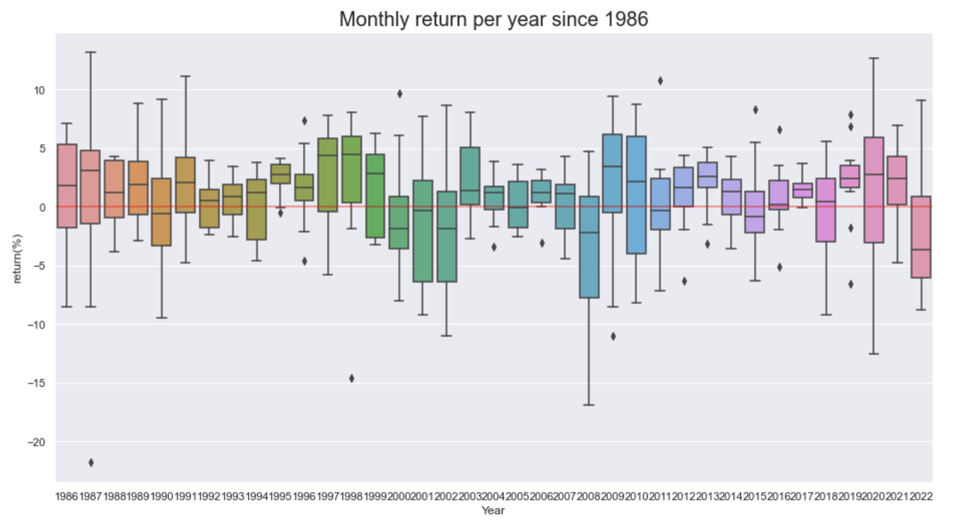
Exploratory Data Analysis
Notes:
This box plots show the monthly return per year since 1986. You can see that the box length gets longer and shorter every few years

Slide 7
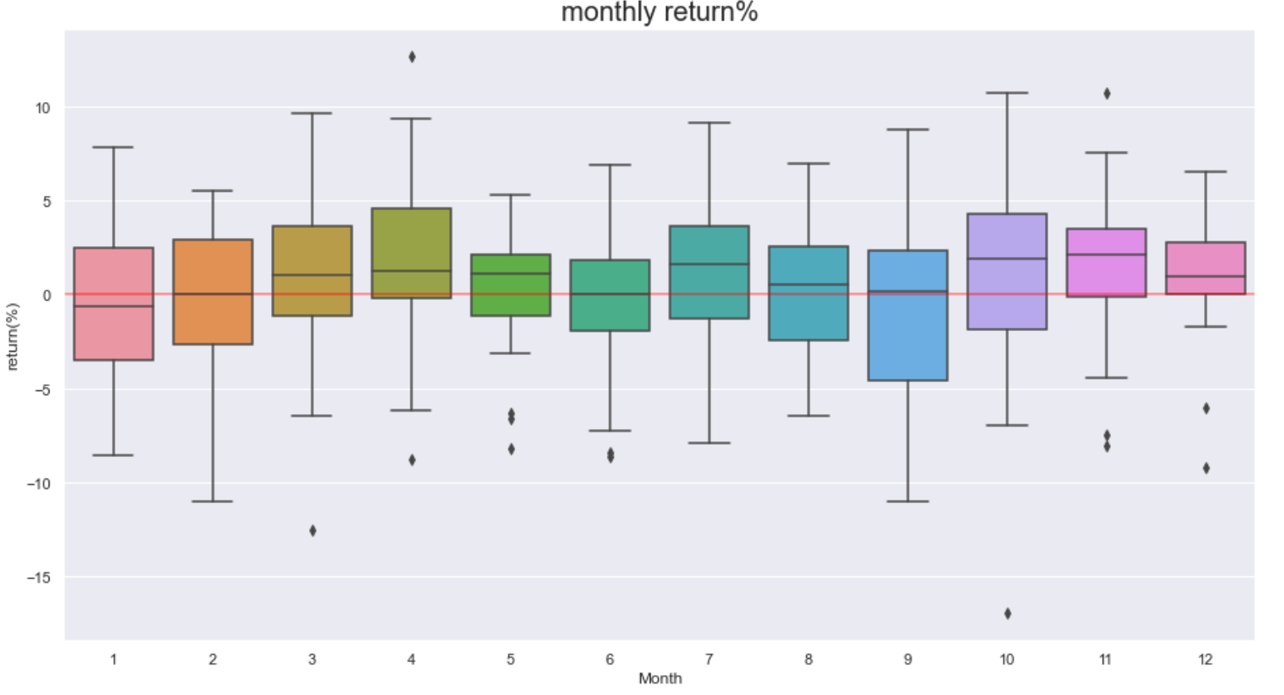
Exploratory Data Analysis
Notes:
This plots show monthly return per month. You can see that January average return is slightly negative and November shows the highest average return.

Slide 8
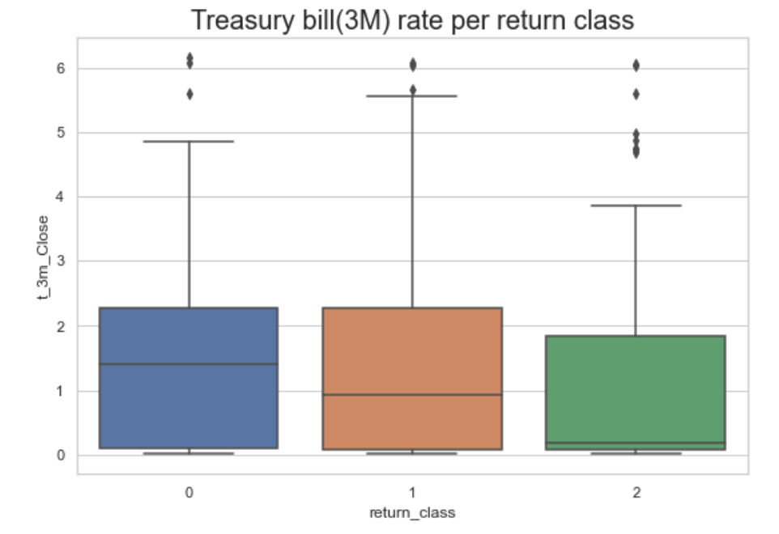
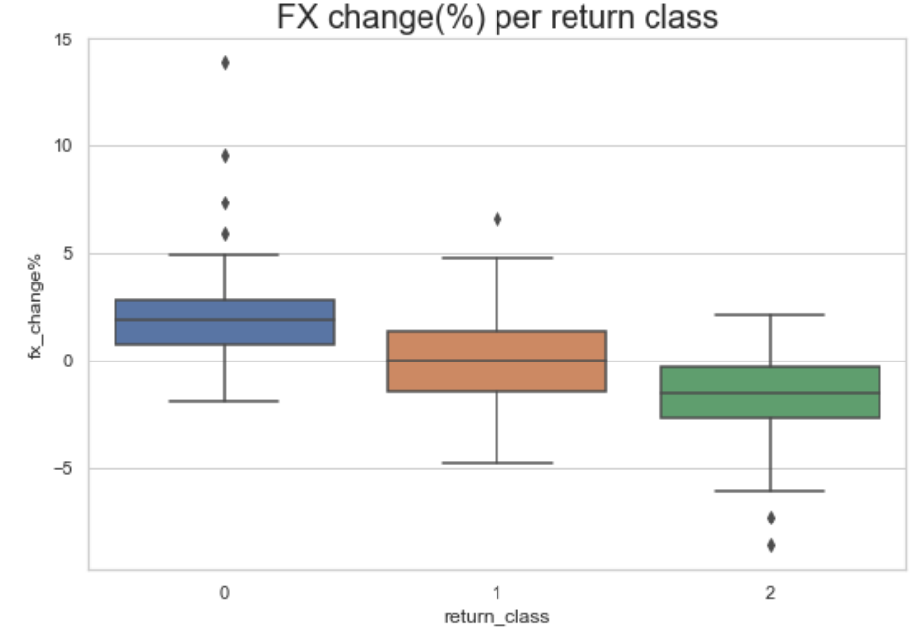
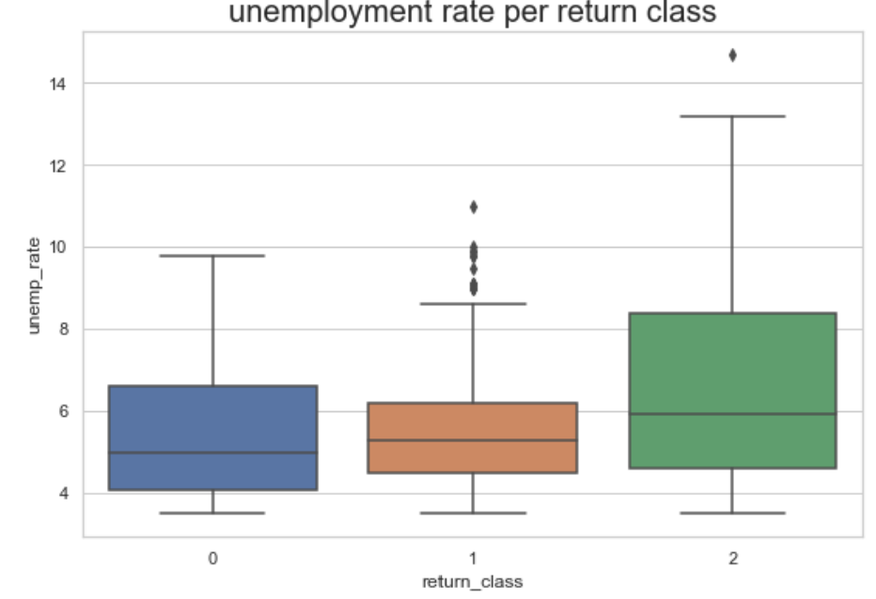
Exploratory Data Analysis
Return class :
2 (market up - monthly return over 3%)
1 (market neutral – monthly return in between -3% to 3%)
0 (market down – monthly return lower than -3%)
Notes:
For classification, I have split return rate as 3 classes. Class 2 is monthly return goes over 3%, class 0 is market going down more than -3%, anything in between is class 1 is as neutral. You can see that treasury bill rate, fx change, unemployment rate changes in different classes.
I’d like to point out the interesting fact that when unemployment rate is higher and economy is in recession, there are more chance that market goes up as the government is trying to boost the market.

Slide 9
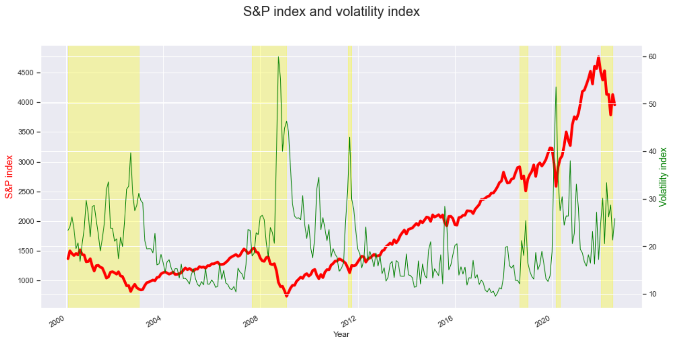
Exploratory Data Analysis
Notes:
Here’s another chart of S&P index with volatility index. You can see that generally when market is down it gets volatile and when the market is gradual the volatility index gets lower.

Slide 10
Model results
Models used:
Logistic Regression, LDA, Naïve Bayes, XGBoost, Random Forest, SVM
Best model:
Logistic Regression, Accuracy: 68.3%, ROC-AUC: 0.704
 | Logistic Regression | LDA | Naïve Bayes | XGBoost | Random Forest | SVM
Accuracy | 0.683 | 0.659 | 0.634 | 0.610 | 0.595 | 0.610
ROC_AUC_score | 0.704 | 0.677 | 0.650 | 0.696 | 0.661 | 0.657
Notes:
For the classification, I used logistic regression, LDA, Naïve bayes, Xgboost, Random Forest and SVM.
The best performed model was logistic regression with 68.3% accuracy (and ROC_AUC score of 0.704)

Slide 11
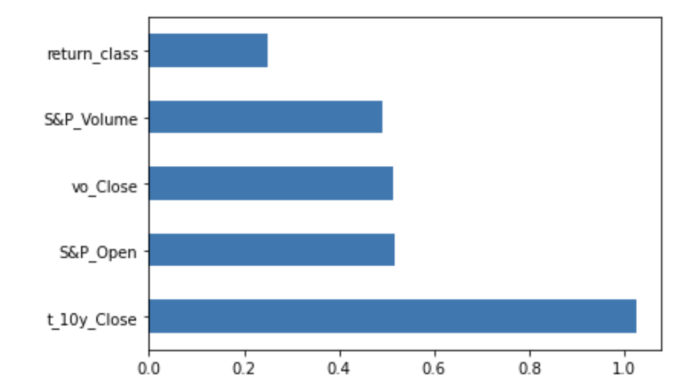
Model results
Feature Importance:
5 largest – Treasury bill (10y) yield, S&P, volatility index, S&P trading volume, current month’s return
Notes:
The 5 features that was most useful at predicting the index classification was that 10 years Treasury bond rate, S&P monthly open price, volatility index, trading volume and current month’s return class. Again my goal was to predict next month’s return based on current monthly info.

Slide 12
Model simulation
Test 1 (Random testset)
Simple return on random test set
21.10%
Actual return on random test set (index ETF)
11.58%
The model outperformed S&P Index!
Test 2 (testset from April 2019 to August 2022)
Compound return on test set
26.97%
Actual return (index ETF)
32.67%
The model underperformed S&P Index!
Notes:
I did a model simulation that how my model could outperform the market.
In my classification model, I used a shuffled testset which is not timely ordered set, and it outperformed the market by approximately 9.5%.
However when I used timely ordered testset from April 2019 to August 2022, my model underperformed than the actual S&P index by 5.7%.

Slide 13
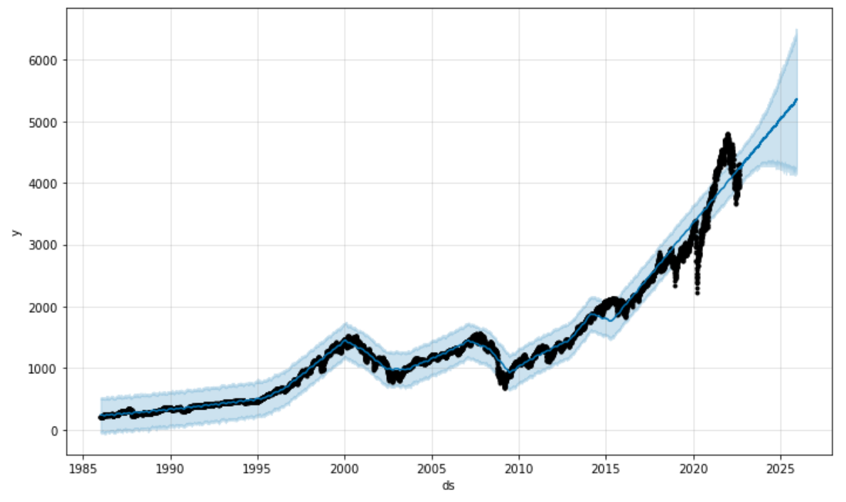
S&P Index prediction – FBprophet
Notes:
To see the how S&P index is going to be headed in the future, I used FB prophet to see the range. This is the next 4 years forecast. Let’s take a closer look at Q4 2022 in the next slide.

Slide 14
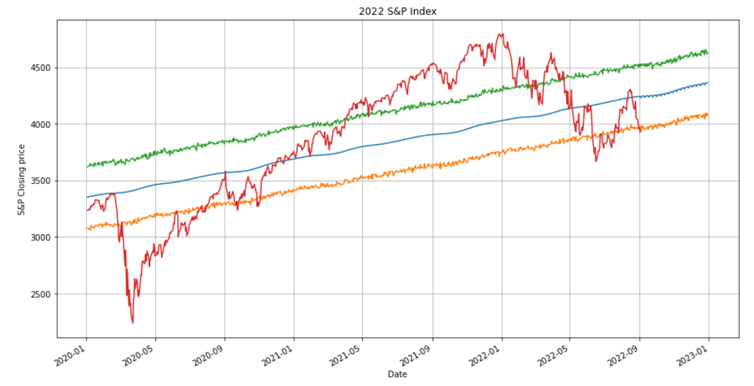
S&P Index prediction – FBprophet
2022 S&P500 Q4 prediction : range of 4,240 to 4,360
Notes:
This is the prediction and trend graph from 2020 to 2022. The red line is the actual S&P closing price, and on the right side is the prediction. Predicted index value in Q4 2022 is in the range of 4,240 to 4,360. You can see that the actual index (red colored) goes down and over the trend line, which is blue. You can consider that when the actual is below the trend, it is the timing to buy S&P index and when the actual is above the trend line, it could be a selling signal.

Slide 15
Key takeaways
Some current information can be a good sign to see the notion of the stock market.
(i.e. treasury bill yield, trading volume, volatility)
We can use time series information and machine learning models to build your own investment strategy.

Slide 16
THANK YOU
And have a successful investment!

